Slide 1
W Alameda Lane Reduction
Abi Subramanian

Slide 2
Agenda
Background – Alameda Ave “After” Study
Opportunities & Current Project Overview
Alternatives Evaluation
Asks of This Team

Slide 3
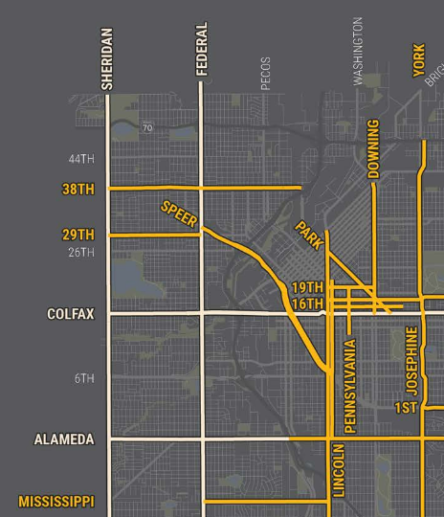
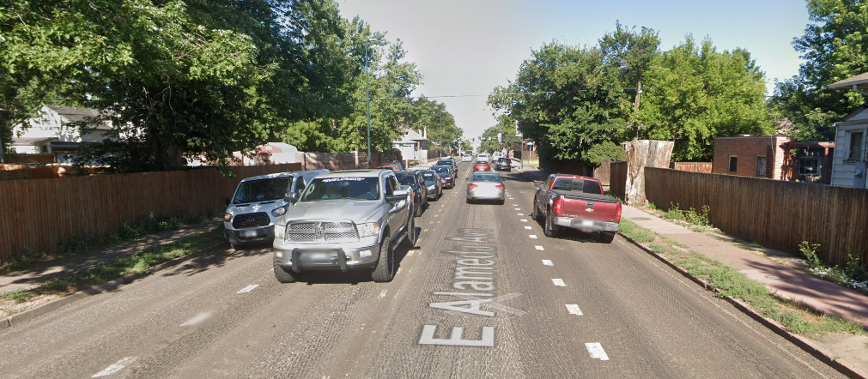
Background – High Injury Network
Signalized Arterial
Posted Speed = 30 mph
4 10’ travel lanes Logan to Franklin (substandard)
15,000-19,000 AADT
RTD Route 3: 1-hour frequency
Alameda is on the HIN (50% of SBI’s/fatalities, 5% of street network)
Notes:
Go through existing conditions, on the HIN

Slide 4
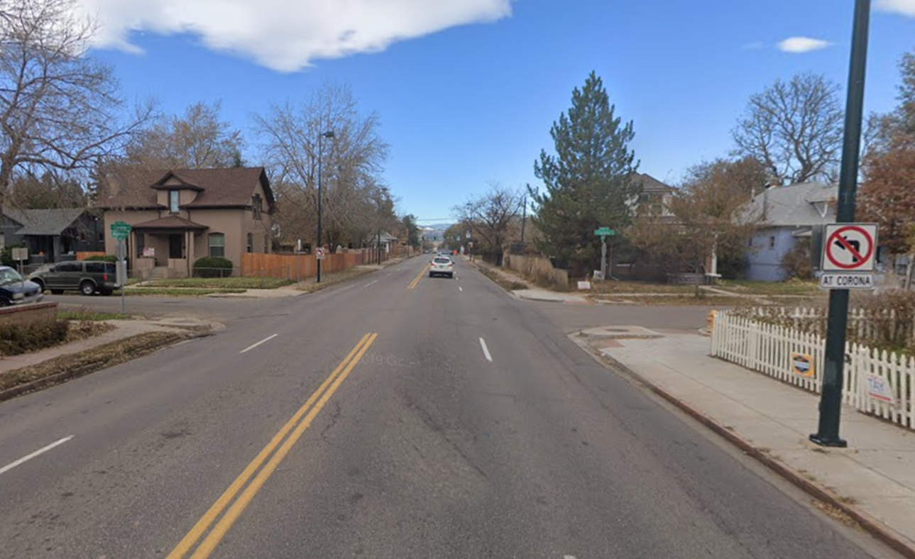
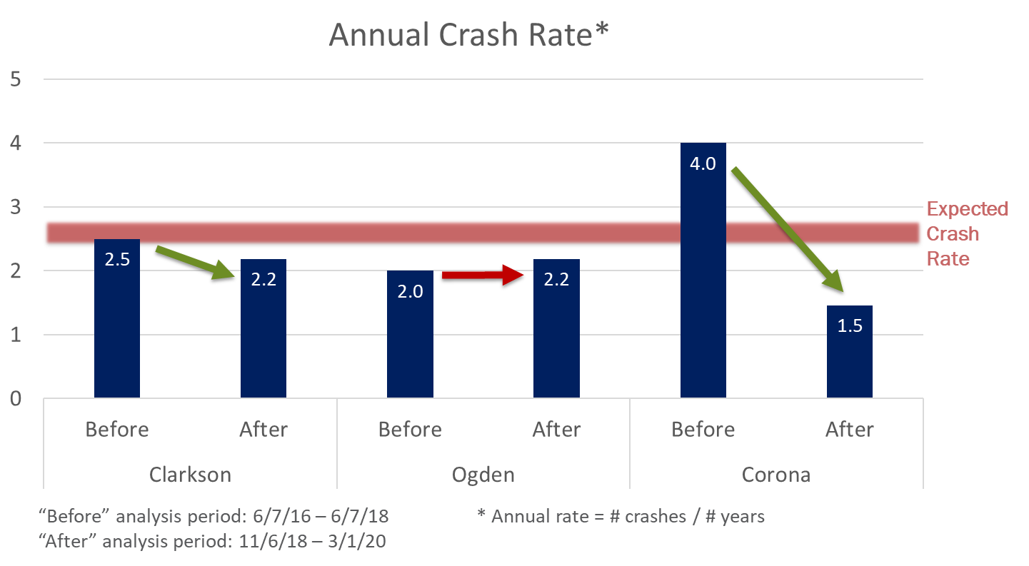
Background – Alameda Left Turn Restrictions
2020: Area Engineer program added restriction of Left Turns at Corona Street
Notes:
Restrictions were implemented in 2018 and the after study was presented to the public in 2020; there was a clear trend of reduction in crashes at these locations

Slide 5
Background – FHWA Guidance
“Four-lane, undivided highways experience a number of crash types as volumes increase:
Rear-end and sideswipe crashes caused by speed differential between vehicles;
Sideswipe crashes caused by frequent and sudden lane changing between two through lanes;
Rear-end crashes caused by left-turning vehicles stopped in the inside travel lane;
Left-turn crashes caused by mainline left-turning motorists feeling pressure to depart the shared through/left lane by following motorists and making a poor gap judgment;
Angle crashes caused by side street traffic crossing four lanes to make a through movement across an intersection, or turning left across two lanes”
Average ADT of Road Diet safety evaluations = 20,000-26,000 ADT
Notes:
Restrictions were implemented in 2018 and the after study was presented to the public in 2020; there was a clear trend of reduction in crashes at these locations

Slide 6
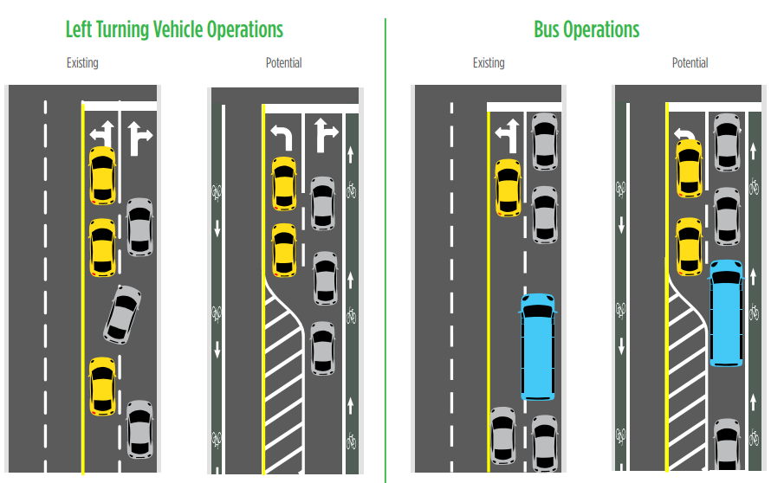
Background – FHWA Guidance
Notes:
Today, many intersections on Alameda do not have left turn lanes.
• Cars wanting to make a left turn stop through traffic behind them, often resulting in risky passing maneuvers.
• A three-lane cross section provides more opportunities for exclusive left turn lanes.
• The safety benefits of exclusive left turn lanes are also expected at unsignalized intersections
RTD buses are wider than the existing 10’ lanes on Alameda.
• Buses have been observed taking up both travel lanes, limiting the capacity of the four-lane section.
• With a three-lane section, the lanes would be widened (10’ to 11’) to fully accommodate wider vehicles and buses.

Slide 7
2021-2022 Crash Analysis
Total: 44 Crashes
15-18% sideswipe or head on
Total: 4 Crashes
2 NB/SB parked vehicles
1 WB LT crash
1 EB rear end
Total: 10 Crashes
3 EB/WB Rear Ends
Total: 6 Crashes
2 NB/SB Thru Crashes, Failure YROW
Total: 8 Crashes
3 EB failure to stop
1 EB rear end
1 EB LT crash
Total: 6 Crashes
2 EB/WB rear end
Notes:
SPF calculated 2018-2020, crash rates calculated 2021-2022

Slide 8
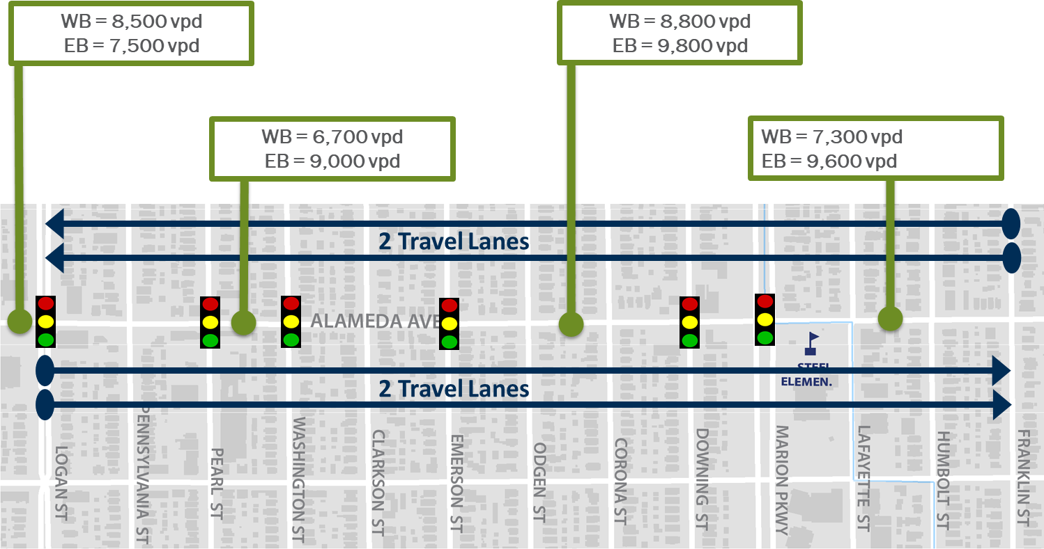
Background – Project Origin
WB volumes warrant evaluation of lane reduction to provide opportunity for:
– Designated LT lanes at INT (expected crash reduction of ~50%)
- Widen substandard lanes
- Physically enforce LT restrictions
- Pedestrian medians and/or bulbouts at select INTs and mid-block
Lane Reduction in WB direction?
Notes:
Restrictions were implemented in 2018 and the after study was presented to the public in 2020; there was a clear trend of reduction in crashes at these locations

Slide 9
Background – Alameda Ave Lane Reduction Study
Purpose: Evaluate Alameda from Lincoln to Franklin to enhance the safety and comfort of all users through a lane repurposing.
Four alternatives with various lane configurations and limits of lane reduction, evaluated based on:
1) Maintain vehicular traffic access to a safe level
2) Support safe & comfortable pedestrian facilities
3) Support transit service
4) Support business access & activity
5) Support neighborhood context, network roles, and corridor “permeability”
6) Improve overall corridor safety
7) Implement fiscally-responsible solution that can be phased, if needed
Notes:
With this coming out of the multimodal program, there is a heavy emphasis on benefiting all roadway users with whichever treatments we identified

Slide 10
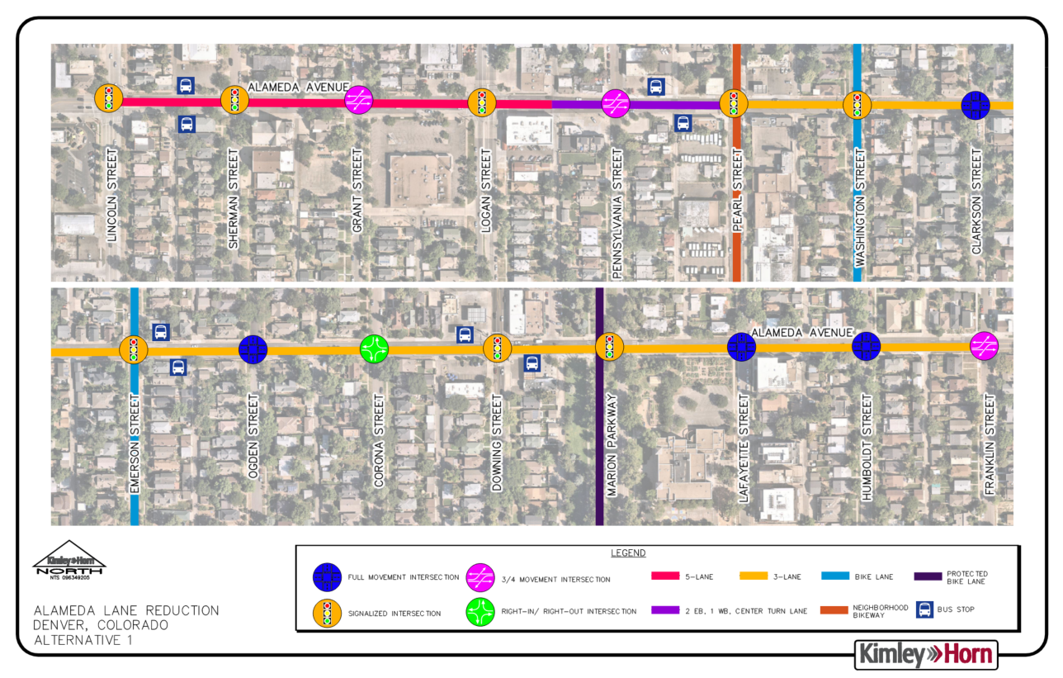
Notes:
In the end, our evaluation led us to two alternatives – Alt 1
5-lane section between Lincoln St to Logan St, 4-lane asymmetrical section between Logan St to Pearl St (2 EBT, TWLTL, 1 WBT), and a 3-lane section between Pearl St to Franklin St with four (3) ¾ movement intersections:
Alameda/Grant
Alameda/Pennsylvania
Alameda/Franklin
*Sensitivity: assumption that 10% of volume on Alameda will reroute to other EB/WB roadways to avoid delay
Additionally, left turns were reintroduced for westbound Pennsylvania St and eastbound & westbound Pearl St.
Left turns were not proposed at Downing St.

Slide 11
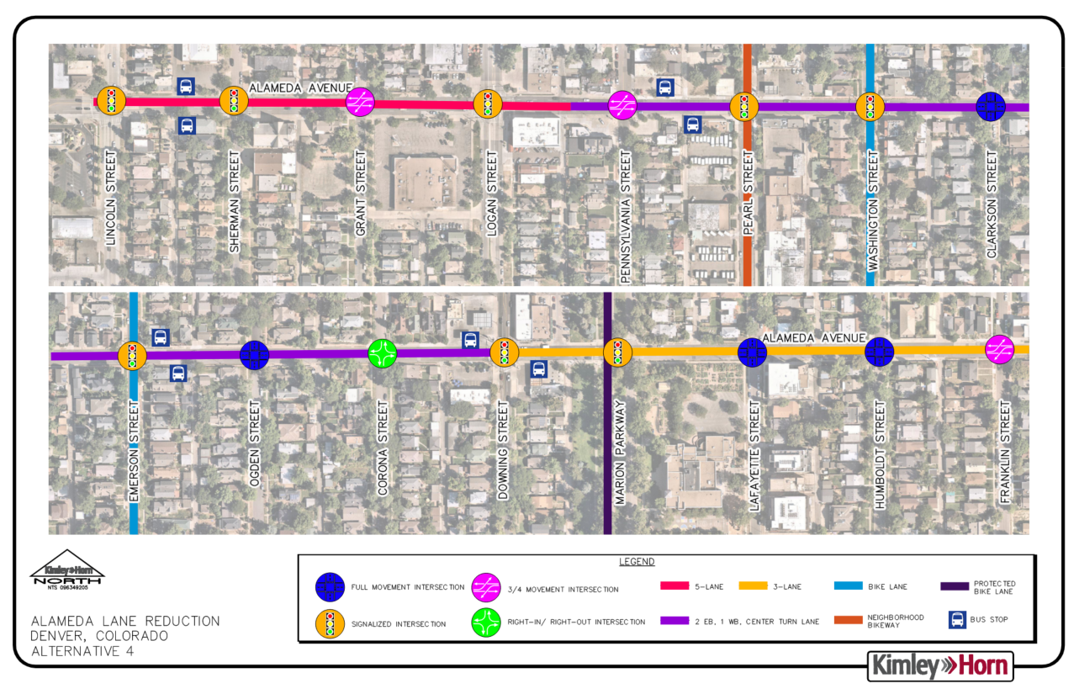
Notes:
Alt 4
5-lane section between Lincoln St to Logan St, 4-lane asymmetrical section between Logan St to Downing St (2 EBT, TWLTL, 1 WBT), and a 3-lane section between Downing St St to Franklin St with four (3) ¾ movement intersections:
Alameda/Grant
Alameda/Pennsylvania
Alameda/Franklin
*Sensitivity: assumption that 10% of volume on Alameda will reroute to other EB/WB roadways to avoid delay
Additionally, left turns were reintroduced for westbound Pennsylvania St and eastbound & westbound Pearl
Left turns were not proposed at Downing St.

Slide 12
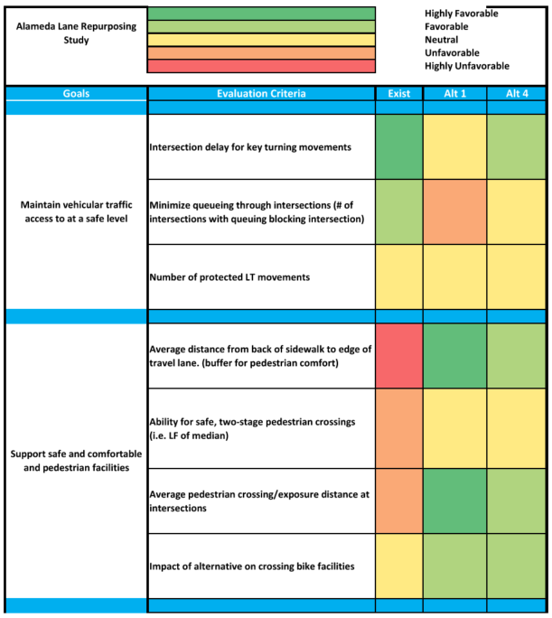
Notes:
Here is the evaluation of those two. Talk through the major differences:
Minor increase in vehicle delay in Alt 1
Generally more pedestrian space and less pedestrian crossing distance in Alt 1

Slide 13
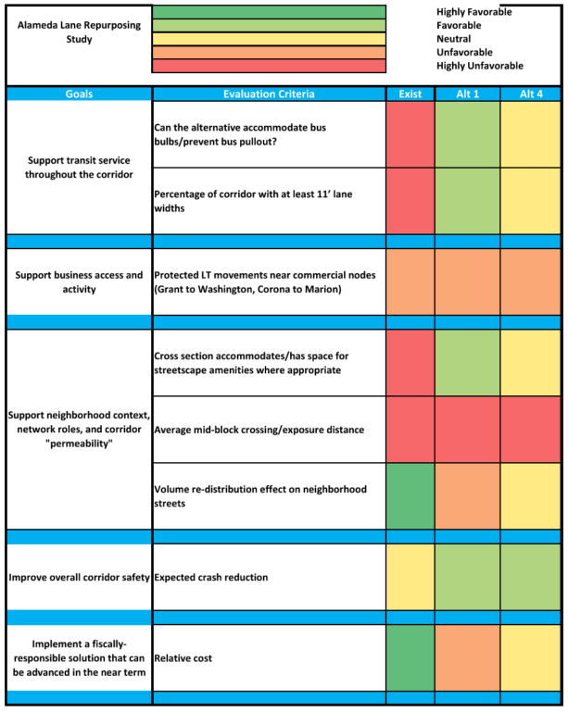
Notes:
Alt 1 better supports transit and more streetscape amenities
Because of more delay in Alt 1, there is slightly more volume re-distribution on neighborhood streets
Alt 1 is slightly more costly than Alt 4

Slide 14
Resulting Benefits of Alternative 1
Designated LT lanes at most intersections (CRF = 50%)
Access control at some unsignalized INTs
(SBI CRF = 24%)
Re-introducing LT lanes on Alameda
Widen to 11’ (standard) lanes
Physically restrict left-turns at Corona
Introduce intersection medians or bulbouts at Downing and mid-block locations (CRF = 25%)
Notes:
In the end, our evaluation led us to two alternatives – Alt 1
5-lane section between Lincoln St to Logan St, 4-lane asymmetrical section between Logan St to Pearl St (2 EBT, TWLTL, 1 WBT), and a 3-lane section between Pearl St to Franklin St with four (3) ¾ movement intersections:
Alameda/Grant
Alameda/Pennsylvania
Alameda/Franklin
*Sensitivity: assumption that 10% of volume on Alameda will reroute to other EB/WB roadways to avoid delay
Additionally, left turns were reintroduced for westbound Pennsylvania St and eastbound & westbound Pearl St.
Left turns were not proposed at Downing St.

Slide 15
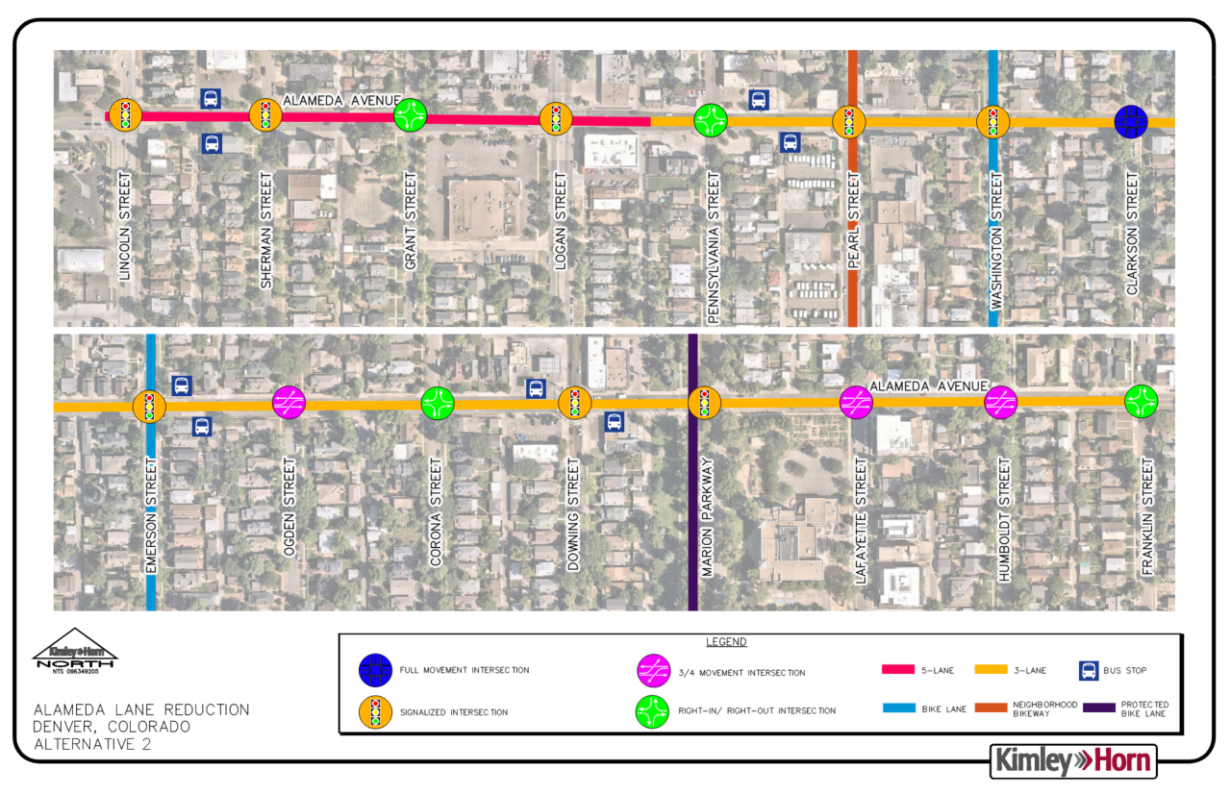
Notes:
With the number of three-quarter and right-in/right-out accesses, Alameda Ave and the side streets were overloaded by restricting movements at every other intersection along the corridor
This alternative was not analyzed further

Slide 16
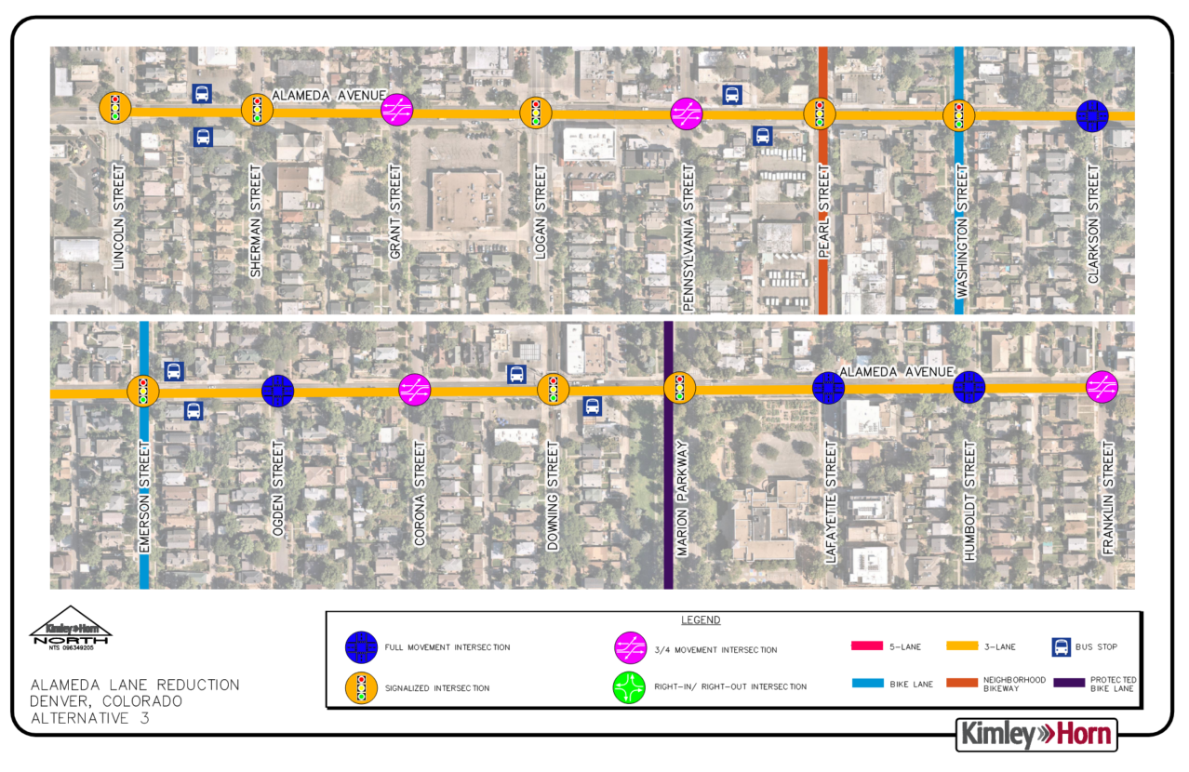
Notes:
Alternative 3 further reduced Alameda Avenue to a three-lane section for the entire stretch of the project. This caused bottlenecking at Lincoln and Sherman Street with the high volume of traffic
entering the corridor from Lincoln Street or Broadway. This alternative was also not further analyzed.

Slide 17
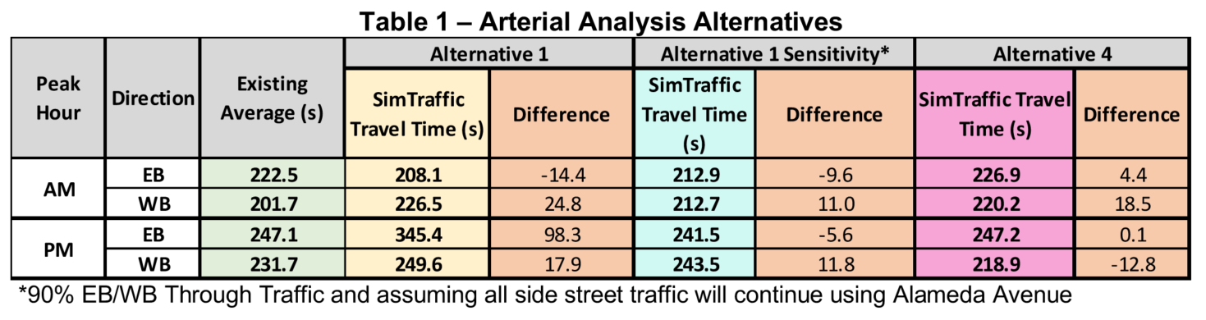
SimTraffic Travel Times Analysis
Notes:
Both Synchro and SimTraffic were used to analyze the alternatives
After ruling Alternatives 2 & 3 out, the team looked at delay for Alt 1, Alt 1 Sensitivity, and Alt 4 after collected travel time data by driving the corridor themselves to use as baseline data

Slide 18
Queuing Analysis – Alternative 1 Sensitivity
Intersection | Direction | Existing Storage (feet) | AM Queue (feet) |  | PM Queue (feet)
 |  |  | Existing | Alt 1 Sensitivity | Existing | Alt 1 Sensitivity
Alameda & Lincoln | EBL | 200 | 139 | 108.5 | 93.5 | 79.5
 | EB | 250 | 322.5 | 248 | 248.5 | 286
 | WB | 250 | 239.5 | 173 | 198.5 | 147
Alameda & Logan | EBL | TWLTL | 156 | 126 | 156 | 149
 | EB | 280 | 251.5 | 180.5 | 314 | 299
 | WBL | TWLTL | 89 | 97 | 119 | 102
 | WB | 275 | 114 | 117.5 | 247.5 | 149.5
Alameda & Emerson | EBL | TWLTL | - | 31 | - | 77
 | EB | 270 | 142.5 | 121 | 256.5 | 263
 | WB | 280 | 125.5 | 329 | 150 | 325
Alameda & Downing | EB | 265 | 165 | 306 | 239.5 | 325
 | WB | 200 | 137.5 | 143 | 150 | 259
Alameda & Marion | EB | 205 | 89 | 75 | 71 | 77
 | WB | 270 | 115 | 167 | 165 | 279
Notes:
Emerson – C
Downing – D
Marion – B
Side streets that will be impacted are Ogden and Lafayette

Slide 19
LOS Analysis – Alternative 1 Sensitivity
Intersection | Control | AM Peak Hour |  |  | PM Peak Hour
 |  | Existing Delay | Delay (s) | LOS | Existing Delay | Delay (s) | LOS
Alameda & Ogden | TWSC
Eastbound Left |  | 7.5 | 17 | C | 9.7 | 6 | A
Westbound Left |  | 3.8 | 3.7 | A | 3.9 | 7.1 | A
Northbound Approach | Stop | 24 | 32.9 | D | 38.7 | 61 | F
Southbound Approach | Stop | 19.5 | 9.7 | A | 27.4 | 40.2 | E
Alameda & Lafayette | TWSC
Eastbound Left |  | 4.9 | 2.8 | A | 7.2 | 4 | A
Westbound Left |  | 11.5 | 9.4 | A | 11.8 | 4.9 | A
Northbound Approach | Stop | 11.7 | 52.4 | F | 22.5 | 75 | F
Southbound Approach | Stop | 14.5 | 56.6 | F | 24.7 | 91.9 | F
Notes:
Alameda & Ogden
NB: 11 during PM peak
Alameda & Lafayette
NB: 10 during PM
SB: ~20 during PM

Slide 20
Alternative 1 – Traffic Analysis
Assumed 10% diversion
Slight increase in delay, some approaches improve (!)
Queuing comparable to current conditions, with few exceptions
Ogden and Lafayette with LOS F (side streets) – only 10-20 vehicles impacted during peak hours

Slide 21
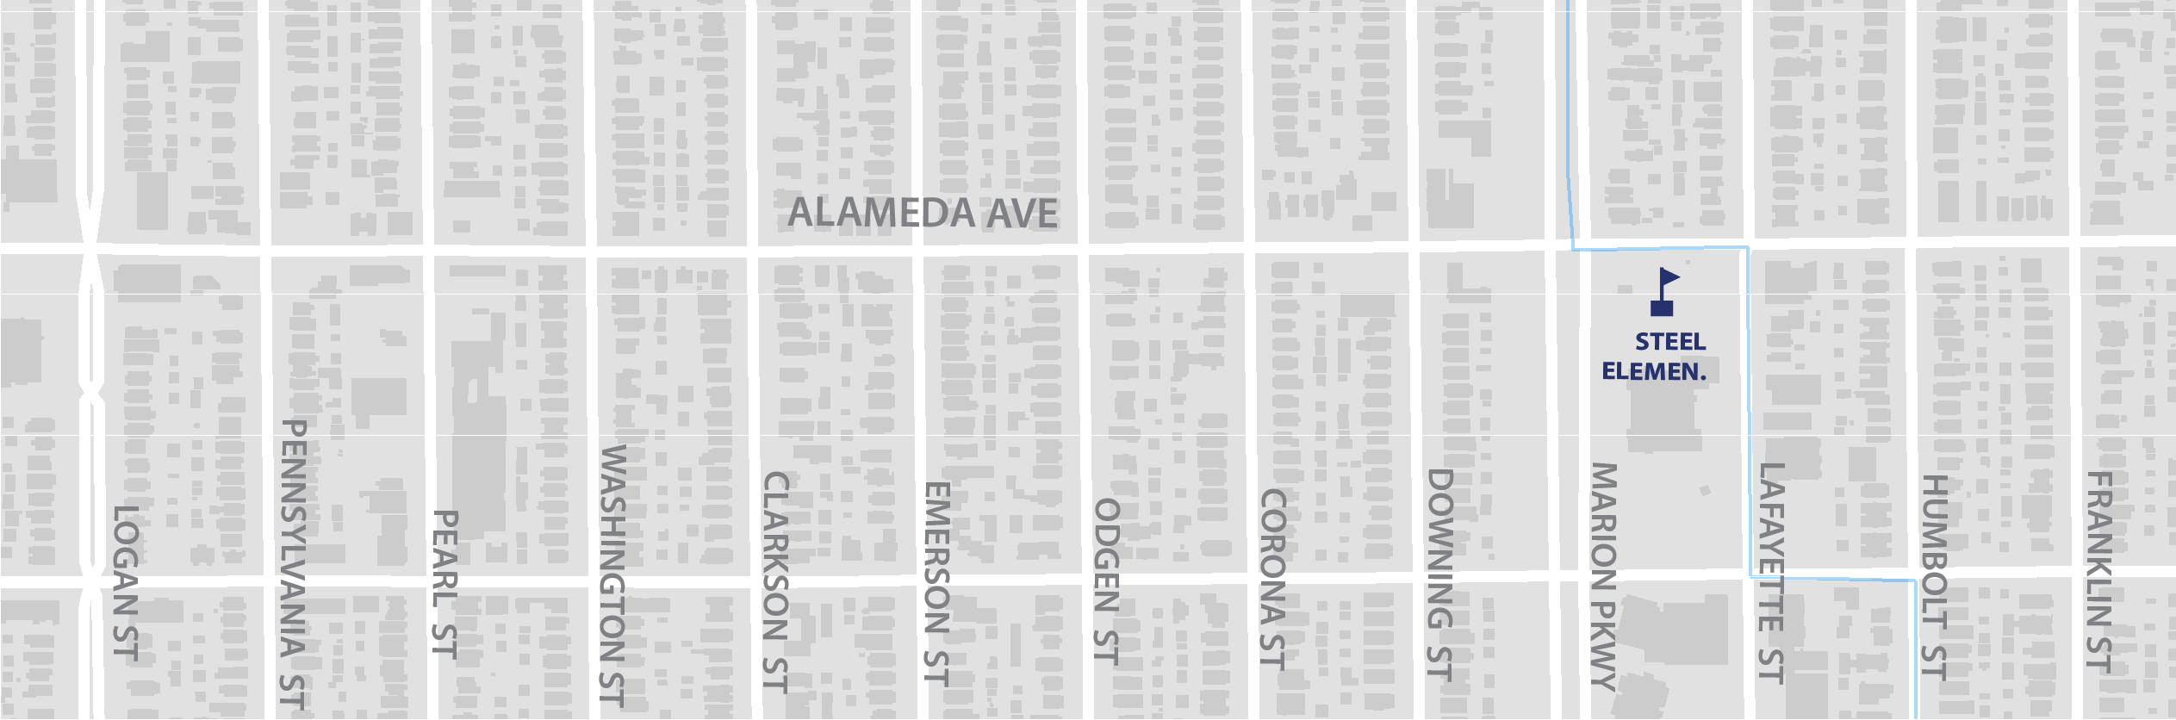
Queuing and Delay Changes
Queue from Downing:
~330’ EB
~260’ WB
Queue from Marion
~280’ WB
Queue from Emerson ~ 330’ WB
LOS F at NB/SB Lafayette
(10-20 vpd)
LOS F at NB Ogden
(11 vpd)
Notes:
In the end, our evaluation led us to two alternatives – Alt 1
5-lane section between Lincoln St to Logan St, 4-lane asymmetrical section between Logan St to Pearl St (2 EBT, TWLTL, 1 WBT), and a 3-lane section between Pearl St to Franklin St with four (3) ¾ movement intersections:
Alameda/Grant
Alameda/Pennsylvania
Alameda/Franklin
*Sensitivity: assumption that 10% of volume on Alameda will reroute to other EB/WB roadways to avoid delay
Additionally, left turns were reintroduced for westbound Pennsylvania St and eastbound & westbound Pearl St.
Left turns were not proposed at Downing St.

Slide 22
Alternative 1 – Diversion Potential
10% total diversion
8% rerouted traffic to Virginia and Speer/1st Ave
2% dispersed to the network
Slight impacts to Virginia and Speer/1st Ave

Slide 23
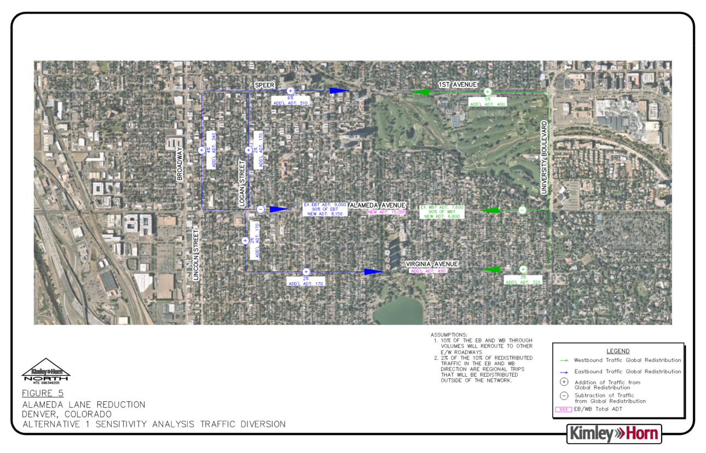
AADT = 2,600
+ 510 vpd (6% EB)
AADT = 50,000
+ 910 vpd (5% WB + 6% EB)
AADT = 28,000
+340 (4%)
AADT = 12,900
+ 170 vpd (2% EB)
90% of EBT
90% of WB
AADT = 12,900
+170 vpd
(2% EB)
2% (EB)
ADD’L ADT: 170
Total:
AADT = 3,200
+ 490 vpd
3% (WB)
ADD’L ADT: 320
Notes:
This volume distribution diagram assumes 10% of volume on Alameda will reroute to other east/west corridors nearby to avoid delays
This is minimal impact to side streets and other roadways

Slide 24
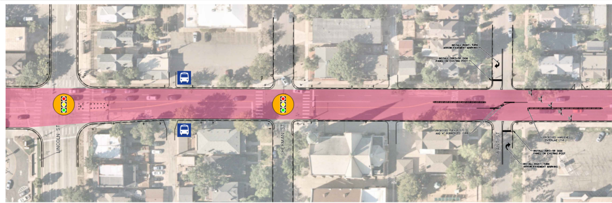
Notes:
Redistributing lane widths to center of the roadway to provide medians, buffered turn lanes, and ped refuges

Slide 25
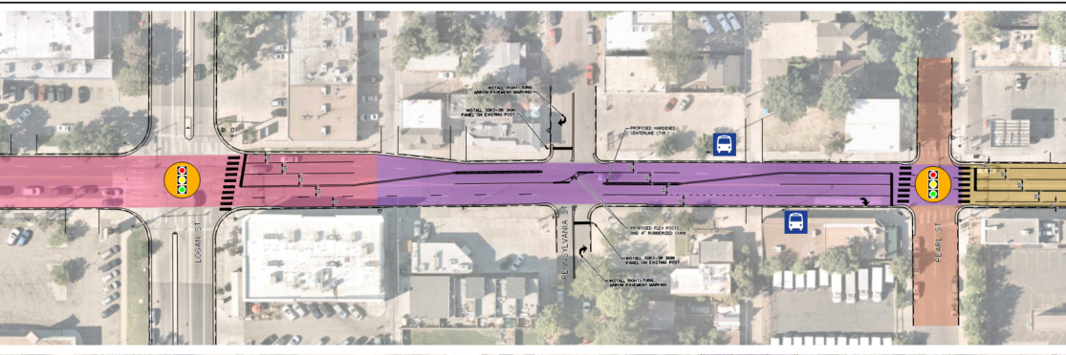
Access control at some unsignalized INTs
(SBI CRF = 24%)
Re-introducing LT lanes on Alameda
Notes:
Redistributing lane widths to center of the roadway to provide medians, buffered turn lanes, and ped refuges

Slide 26
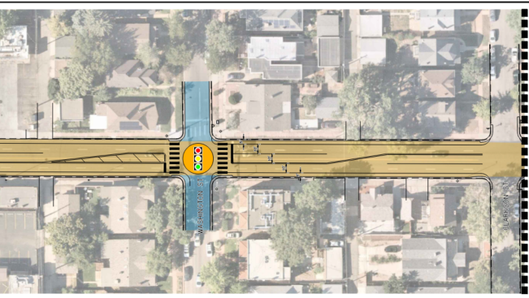
Notes:
Redistributing lane widths to center of the roadway to provide medians, buffered turn lanes, and ped refuges

Slide 27
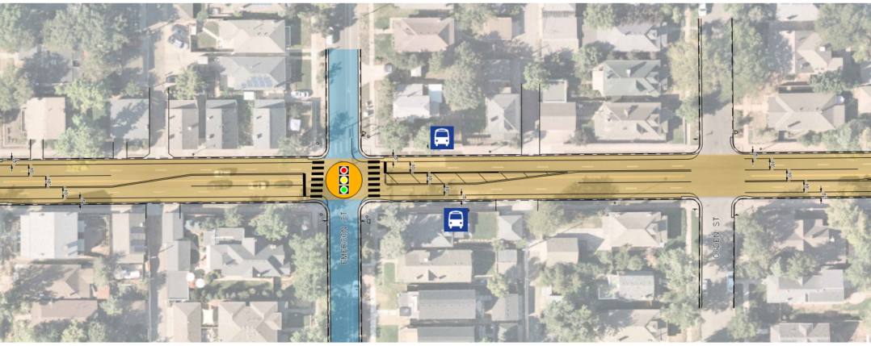
Intersection medians to provide ped refuge and narrow intersection
Designated LT lanes at most intersections (CRF = 50%)
Notes:
Redistributing lane widths to center of the roadway to provide medians, buffered turn lanes, and ped refuges

Slide 28
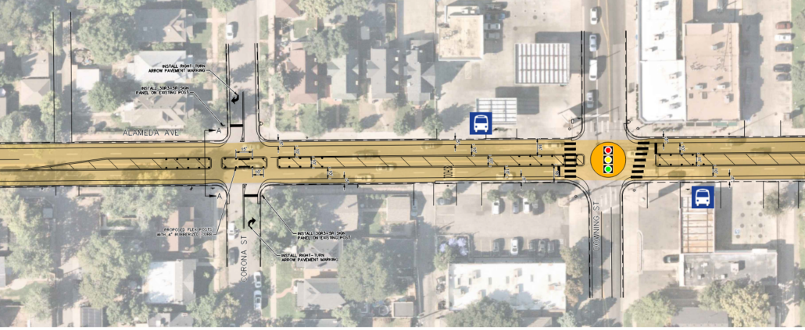
Physically restrict left-turns at Corona
Introduce intersection medians and bulbouts at Downing and mid-block locations (CRF = 25%)
Notes:
Redistributing lane widths to center of the roadway to provide medians, buffered turn lanes, and ped refuges

Slide 29
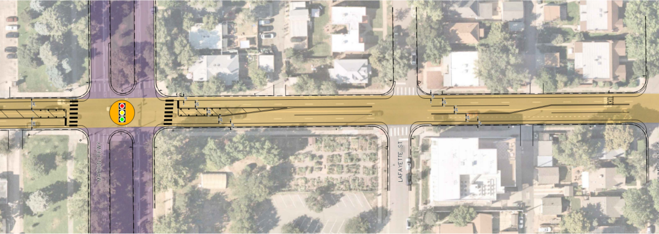
Notes:
Redistributing lane widths to center of the roadway to provide medians, buffered turn lanes, and ped refuges

Slide 30
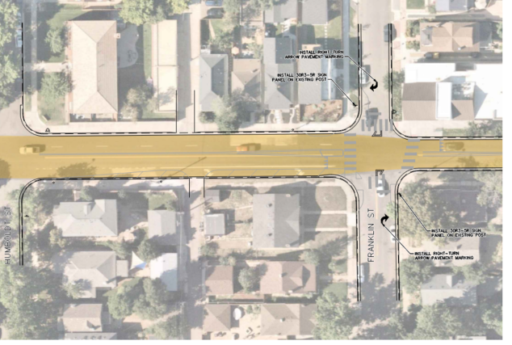
Notes:
Redistributing lane widths to center of the roadway to provide medians, buffered turn lanes, and ped refuges

Slide 31
Conceptual Costs*
Option 1: $250k for Franklin to Pearl, paint/post treatments
These extents include 4 bike facilities on Pearl, Washington, Emerson, and Marion
Additionally this encompasses bus stops at Emerson and Marion
Option 2 :$460k for Franklin to Lincoln, paint/post treatments
Treatments include rubberized curbs/post ¾ access control and hardened centerlines at Grant and Pennsylvania (these treatments are costly)
Additionally this encompasses the bus stops between Pennsylvania and Pearl
*Both cost estimates account for a 30% contingency fee on construction materials
Notes:
$ Striped center median: $28k/block x 15 blocks = $420k
$$ Raised center median: $110k/block x 15 blocks = $1.65mil
$ Striped edge buffer: $25k/block x 15 blocks = $375k
$$$ Raised edge buffer: $230k/block x 15 blocks = $3.45mil

Slide 32
Cost Considerations
Designated LT lanes at most intersections (CRF = 50%)
Access control at some unsignalized INTs
(SBI CRF = 24%)
Option 2 Ext ($460k)
Re-introducing LT lanes on Alameda
Option 1 ($250k)
Widen to 11’ (standard) lanes
Physically restrict left-turns at Corona
Introduce intersection medians or bulbouts at Downing and mid-block locations (CRF = 25%)
Notes:
In the end, our evaluation led us to two alternatives – Alt 1
5-lane section between Lincoln St to Logan St, 4-lane asymmetrical section between Logan St to Pearl St (2 EBT, TWLTL, 1 WBT), and a 3-lane section between Pearl St to Franklin St with four (3) ¾ movement intersections:
Alameda/Grant
Alameda/Pennsylvania
Alameda/Franklin
*Sensitivity: assumption that 10% of volume on Alameda will reroute to other EB/WB roadways to avoid delay
Additionally, left turns were reintroduced for westbound Pennsylvania St and eastbound & westbound Pearl St.
Left turns were not proposed at Downing St.

Slide 33
Phasing
Option 1: Currently $250k available in RISE bond funding
~$50k needed for design
Option 2: Add additional $210k to extend project to Lincoln
~$60k needed for design
Notes:
Add retiming of the signals within project limits. TME to procure consultant and pay for this.
If cost of construction overruns $250k, then what? Vision Zero funding(?)
Use ad alts to include varying levels of investment in addition to Pearl to Franklin
?
Notes:
$ Striped center median: $28k/block x 15 blocks = $420k
$$ Raised center median: $110k/block x 15 blocks = $1.65mil
$ Striped edge buffer: $25k/block x 15 blocks = $375k
$$$ Raised edge buffer: $230k/block x 15 blocks = $3.45mil

Slide 34
Thank you!

